Slide 1

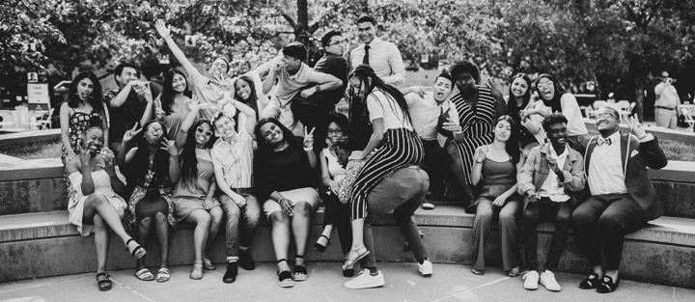
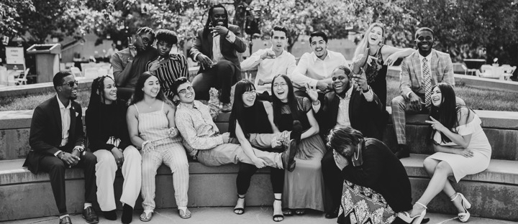
Presentation at a Low-Income School
CLASS GUIDEBOOK
2021
The Opportunity
Your stories of leadership and resiliency are inspiring to younger students who see you as role models. It is important that you both engage with and motivate other students to follow in your footsteps for higher education and be a resource for others.
By presenting at a low-income school, you will have the opportunity to sharpen your public speaking skills and improve your process of preparation. More importantly, you are deliberately and positively influencing a younger generation of students to pursue higher education and a successful future beyond high school. You are playing a direct role in inspiring the leaders of tomorrow.
Your Accountability
At some point during your four years in the program, you are expected to conduct at least one presentation at a school of your choice that serves a low-income community. You may choose a high school or middle school. You may speak with multiple students across grades for an optimal impact, or you may speak with a smaller group of students, through a class or school club.
Before June 20th of your senior year, you must send us a photo and/or video of you speaking at a school. You can do so via email to our program staff or you can submit a recap in your Accountability surveys, due January 20th and June 20th.
Please tell us in advance when you’re planning to visit a school—we’d love to support you by attending or sending one of our community members if appropriate.

Slide 2
Presentation at a Low-Income School
CLASS GUIDEBOOK
The following is a step-by-step guide for how to complete this component.
Step 1 – Determine what message you want to deliver
There are many ways in which you can inspire the next generation of leaders. You can inspire them through your story and accomplishments, you could teach them a new topic or skill, you could share with them your experiences in college and what you’ve learned… but there are certain non-negotiable elements to include. Use this Content Development Guide to create your final presentation.
Who are you?
Tell your story to captivate the audience and make your content relatable. (A college student, a Greenhouse Scholar, a runner, an entrepreneur… what have you overcome?).
Why are you here (purpose for presenting and why to this audience)?
What are you a subject area expert on?
What knowledge can you impart?
  Time management in college.
  How to make the decision on where to go to college.
  What opportunities to say yes/no to.
Share your goals and accomplishments (refer to your Individual Impact Plan!).
What can you share about Greenhouse Scholars?
  How has mentorship affected your life?
  What have you learned about professional networking?
  What cool things have you accomplished through Flex Funding?
  What is the intended goal of your Community Impact Initiative?
  Etc.
Feel free to use this Greenhouse Scholars PowerPoint template and insert your own information and content.
Partner with other Scholars
One way to amplify your message and create a more impactful presentation is to co-present with one or more Scholars.
  Follow Step One above and identify any shared messages or experiences you and your partner(s) would like to focus on.
Notes:
Vision from Pete:
Creating something that we haven’t done before figuring out in the doing of it what is the best way to do it - the doing of it is the best way to decide how it works
What it could become and what it means
This is community service - fits the framework of how they work - hard is good sometimes.
Everybody has 100 reasons why not - busy, overwhelmed, mental health - how do you talk about them without them becoming roadblocks
Have to get people to buy-in to a shared vision - be bought into the value of the vision - if there is any hint of doubt about the vision it won't work – belief
Nobody knows how to do this and how it's going to go but you have to have a belief that something will come out of it that is lasting - we're getting thrown in together we provide a framework, facilitation, and volunteers that are experts.

Slide 3
Presentation at a Low-Income School
CLASS GUIDEBOOK
Step 2 – Determine who your audience will be
Now that you have your story, determine who you want to inspire!
Audience Selection & School Identification
Determine if you want to:
Present to high school or middle school students.
Target a broad or specific audience (i.e., entire school vs. the robotics club vs. your favorite teacher’s English class).
Target a specific State, city, or neighborhood.
Present to a specific type of school:
  The middle school or high school that you attended
  Alternative
  Public
  Private
  Charter
  Online
  Gifted
  Performing Arts
  Military
  Special Needs
Step 3 – Reach out to the school you’ve selected and begin the conversation
Don’t be overwhelmed by the idea of reaching out to a school and asking them for the opportunity to present to their students. See this template email for an idea on how to begin this conversation. Also, don’t hesitate to reach out to Greenhouse Scholar program staff and your mentor to ask for guidance.
Helpful tips on how to reach out to your selected school:
Do your homework!
Before calling/emailing a school, go onto their website and identify the person you’d like to speak with and their contact information.
Direct the message directly towards them (i.e., Dear Mrs. Thompson or Hello Mr. Muñoz).
Notes:
Vision from Pete:
Creating something that we haven’t done before figuring out in the doing of it what is the best way to do it - the doing of it is the best way to decide how it works
What it could become and what it means
This is community service - fits the framework of how they work - hard is good sometimes.
Everybody has 100 reasons why not - busy, overwhelmed, mental health - how do you talk about them without them becoming roadblocks
Have to get people to buy-in to a shared vision - be bought into the value of the vision - if there is any hint of doubt about the vision it won't work – belief
Nobody knows how to do this and how it's going to go but you have to have a belief that something will come out of it that is lasting - we're getting thrown in together we provide a framework, facilitation, and volunteers that are experts.

Slide 4
Presentation at a Low-Income School
CLASS GUIDEBOOK
Have your “one-minute pitch” well-rehearsed concerning:
  Why you want to give a presentation.
  Why you believe it will be impactful for their students.
  How long you would like to present.
  Which students or groups you would like to target.
Ask them if they have any questions for you.
If you plan on using a PowerPoint, video, or other digital content, ask if you will have access to a computer and the necessary equipment.
Ask them for days/times that work best, then suggest a date and time.
Thank them for their time and for the opportunity.
  Follow-up with a thank you email!
What if you want to present to the middle school or high school that you attended? --- GREAT!!!
Think about that teacher, counselor, coach, or other staff member that you had the greatest relationship with. The person who inspired you, pushed you, or helped you through a hard time. That’s the person you should contact about your presentation!
Step 4 – Take care of business
You’ve done the hard part, congratulations! Your presentation is ready, you know your target audience, and you know when and where you’re presenting. So, what’s left?
Practice!
The more you practice your presentation, the more confident and less nervous you’ll be the day of.
  Practice your presentation in front of an audience:
    Roommates
    Friends
    Family
    Program Staff
    Mentor
Notes:
Vision from Pete:
Creating something that we haven’t done before figuring out in the doing of it what is the best way to do it - the doing of it is the best way to decide how it works
What it could become and what it means
This is community service - fits the framework of how they work - hard is good sometimes.
Everybody has 100 reasons why not - busy, overwhelmed, mental health - how do you talk about them without them becoming roadblocks
Have to get people to buy-in to a shared vision - be bought into the value of the vision - if there is any hint of doubt about the vision it won't work – belief
Nobody knows how to do this and how it's going to go but you have to have a belief that something will come out of it that is lasting - we're getting thrown in together we provide a framework, facilitation, and volunteers that are experts.

Slide 5
Presentation at a Low-Income School
CLASS GUIDEBOOK
  Time the presentation and make sure it is within the allotted time that your school contact has given you.
  See this list of presentation best practices.
Look good. Feel good. Do good.
On the day of your presentation, plan on being the best-dressed person in the whole room. Psychology shows that when someone is confident in their appearance, they actually become MORE confident.
Contact Greenhouse Scholar program staff to let them know about your upcoming presentation. We might want to come watch!
Ask to have someone take your picture! This is an awesome moment for you, and we don’t want to forget it. Capture this day on film, in your mind, and allow Greenhouse Scholars staff and our community to celebrate with you.
Step 5 – Reach out to Greenhouse Scholars program staff
You’ve worked hard to be where you are today, please brag about it to us!
Before June 20th of your senior year, you must send us a photo and/or video of you speaking at a school. You can do so via email to our program staff or you can submit a recap in your Accountability surveys, due January 20th and June 20th.
Notes:
Vision from Pete:
Creating something that we haven’t done before figuring out in the doing of it what is the best way to do it - the doing of it is the best way to decide how it works
What it could become and what it means
This is community service - fits the framework of how they work - hard is good sometimes.
Everybody has 100 reasons why not - busy, overwhelmed, mental health - how do you talk about them without them becoming roadblocks
Have to get people to buy-in to a shared vision - be bought into the value of the vision - if there is any hint of doubt about the vision it won't work – belief
Nobody knows how to do this and how it's going to go but you have to have a belief that something will come out of it that is lasting - we're getting thrown in together we provide a framework, facilitation, and volunteers that are experts.

